Slide 1
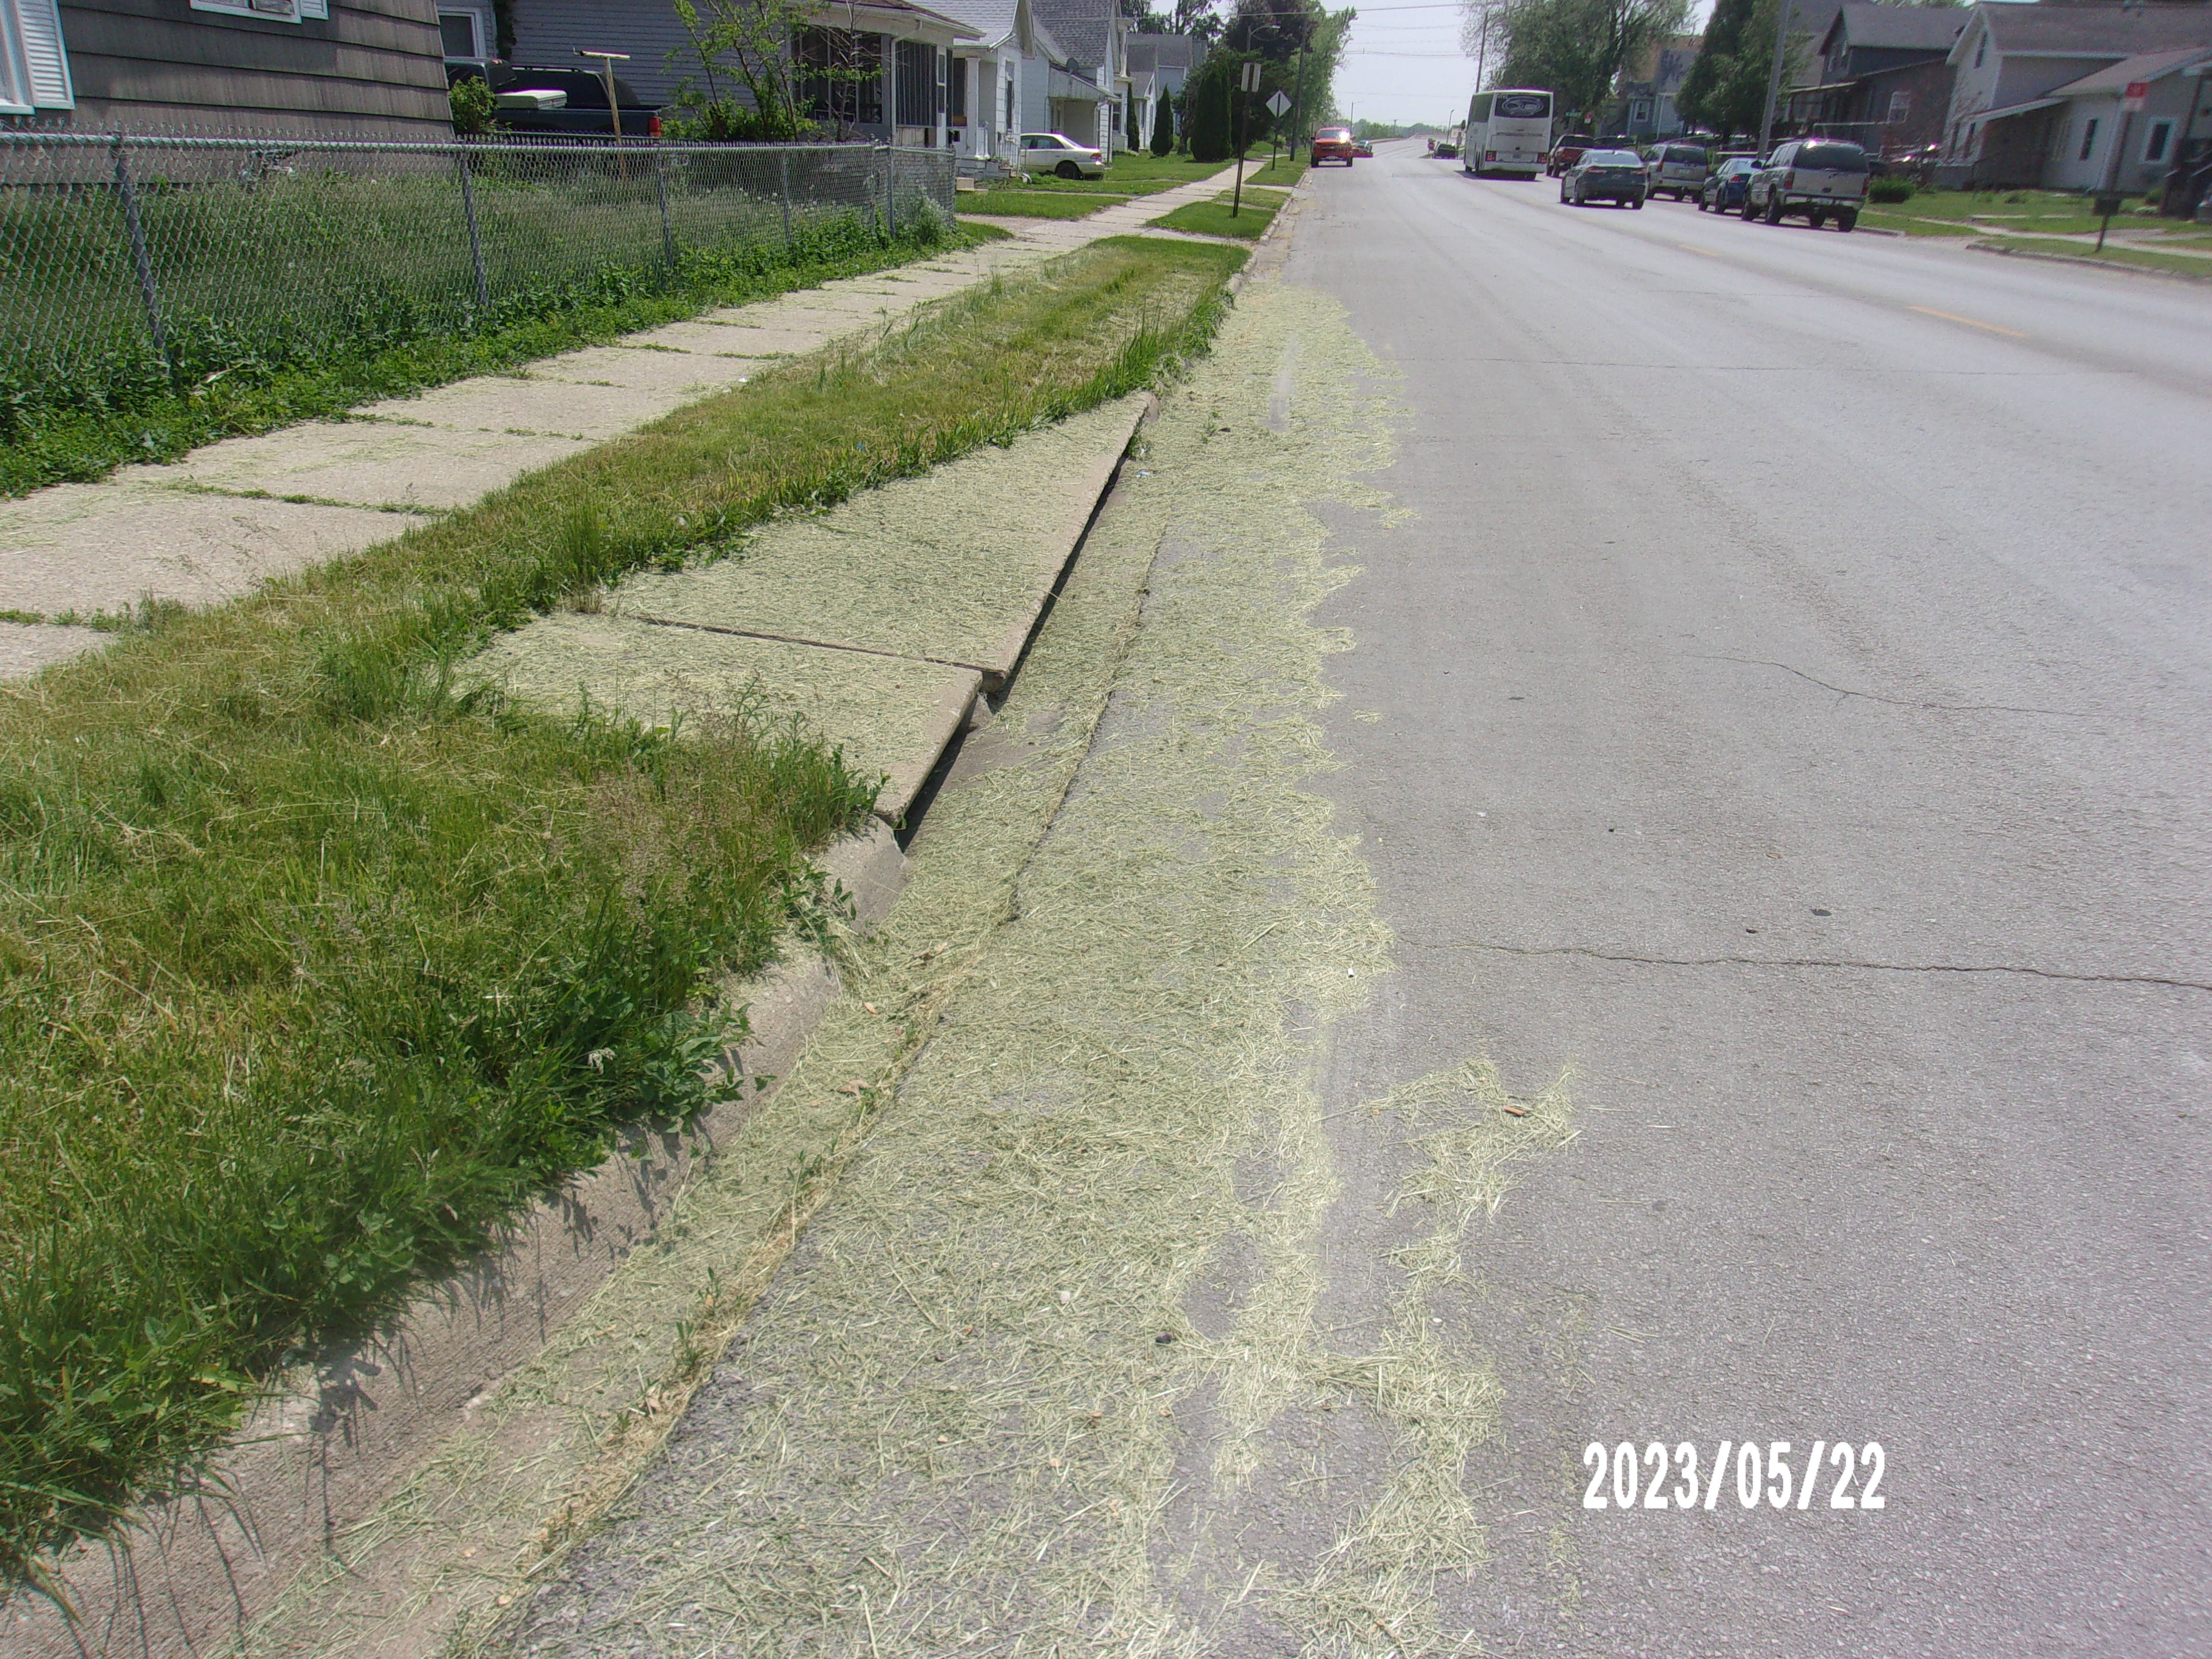
"please don't mow your grass into the street"
It’s against the city code
It’s dangerous for bicyclists
It will end up in the city sewer system
Only clean water allow in the street
If it happens, please clean it up!

